Slide 1
Carnival of Spookyness
PASS Speaker Idol 2019
William Assaf

Slide 2
Agenda of Terror
HORRIFYING nonsequential newsequentialid() GUIDs
SHOCKING foreign key behavior
TERRIFYING duplicate primary keys

Slide 3
Carnival of SQL Spookyness
Scary, frightening database monsters!
Proceed only if you dare! We are not responsible for any injuries resulting from previously existing medical conditions.
Features of night, brought to light!

Slide 4
Fright #1
Proceed only if you dare, and have never thought that using newsequentialid() is a good idea!
Behold, the terror of the newsequentialid()!

Slide 5
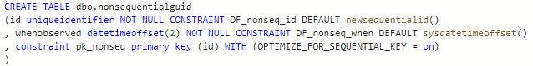
Nonsequential newsequentialid()
To set the stage we create a table with a uniqueidentifier column as the primary key and clustered index, using the newsequentialid() function as a default.

Slide 6
Nonsequential newsequentialid()
Ran some inserts, caused some things to happen, and then…

Slide 7
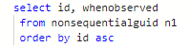
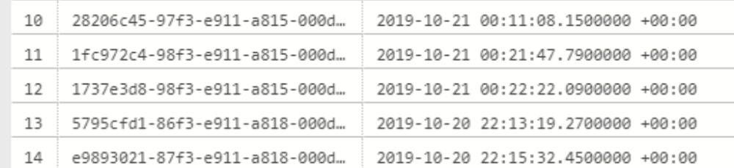
Nonsequential newsequentialid()

Slide 8
INSERT SORT ORDER
Expected behavior
of newsequentialid()
Actual behavior
when seed changes
Server change!
Server change!
Server change!
Server change!
Server change!
Server change!
Server change!
No Fragmentation
Fragmentation Upon Insertion

Slide 9
HowTo: Nonsequential sequential GUID
Failover to another machine in FC or AG
Upgrade or Migrate to new hardware
Upgrade or Migrate to new platform
Change the tier of Azure SQL DB
Reimage an Azure VM with ephemeral OS
Any change to SQL Server’s NIC’s MAC

Slide 10
HowTo: Nonsequential sequential GUID
The C++ function UuidCreateSequential is based on the MAC address of the NIC.
"Therefore you should never use this UUID to identify an object that is not strictly local to your computer.“
Which may rule out any High Availability or portability! Scary!

Slide 11
Fright #2
Proceed only if you dare, and have never thought that foreign keys were magical! Behold, the shocking truths behind foreign keys!

Slide 12
Fright #3
Proceed only if you dare, and have ever thought the float data type was trustworthy! Behold, duplicate primary key horror!

